Slide 1

IntelliCare ER: Enhancing Emergency Room Operations with MIMIC-IV Dataset Presented by Group 10

Slide 2

Group Members
Jerusha Sheba Maben - 0825449.
Pearlin Ronald Pereira - 0815060.
Eduardo Chavez Barrientos - 0828349
Noushin Asadsamani - 0829532.

Slide 3

Introduction
The introduction of an innovative Emergency Room (ER) management system based on the MIMIC-IV dataset is poised to revolutionize hospital operations.
The ER system is projected to increase healthcare delivery efficiency while also contributing to data-driven decision-making by combining real-time patient tracking, medication reconciliation, diagnosis analysis, and other essential features. The incorporation of the MIMIC-IV dataset provides an unparalleled potential to tailor ER operations to patients' particular needs, ultimately leading to improved outcomes and resource efficiency.

Slide 4

Background and Motivation
Background:
Healthcare Challenges: Traditional ER operations face hurdles in optimizing patient care and overall efficiency.
MIMIC-IV Dataset Opportunity: Leveraging data from a Boston-area academic medical center to understand patient scenarios and hospital processes.
Motivation:
Enhancing Emergency Room Efficiency: Our goal is to develop a sophisticated system for predicting wait times in emergency rooms, aimed at improving resource allocation and patient satisfaction.
Specific Pain Points: Focusing on predicting wait times to optimize patient prioritization, resource utilization, and overall efficiency in emergency room operations.
In essence, our initiative is driven by the urgent need to address wait time challenges in emergency rooms, harnessing the predictive power of the MIMIC-IV dataset to optimize patient outcomes and operational effectiveness.

Slide 5


Slide 6
Table 1 : The diagnosis table records the diagnosed conditions of patients treated in the emergency department.
Table 2 : the "edstays" table, tracks the time patients arrived at and left the emergency department.
Table 3 : The "medrecon" table stores the medications reported by patients upon admission to the emergency department, a process known as medicine reconciliation.
Table 4 : The "pyxis" table contains data about medication dispensations facilitated through the Pyxis system.
Table 5: The "triage" table stores data on patients' initial assessments upon arrival in the emergency department, including vital signs, acuity levels, and prioritization for care.
Table 6: The vitalsign table records patients admitted to the emergency department that have routine vital signs taken ever 1-4 hours.

Slide 7
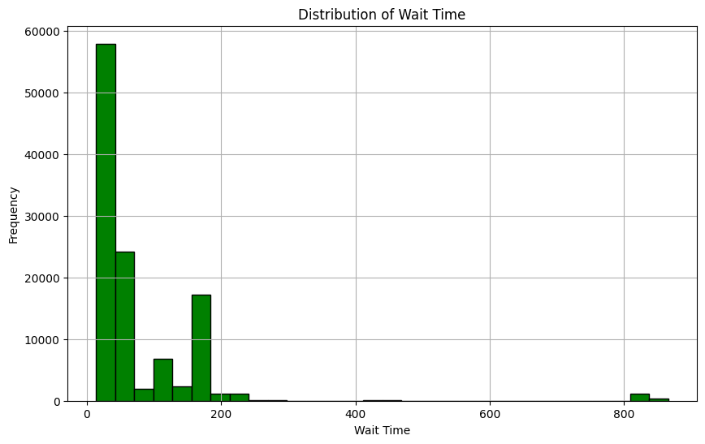
Distribution of waiting time in ER
Peak at Short Wait Times (0-30): This is the most common wait time. This could be due to efficient triage
Less Frequent Wait Times (30-200):These wait times are also frequent, but not as 0-30 minutes. This could be due to the time it takes to treat more severe cases that require immediate attention but are not life-threatening.
Rare Long Wait Times (400 and 800): These wait times are very rare. This could be because such long waits are generally avoided in emergency rooms as they could lead to worsening of the patient’s condition. However, in some cases, they might be unavoidable due to high patient volume, understaffing, or a high number of severe cases.

Slide 8
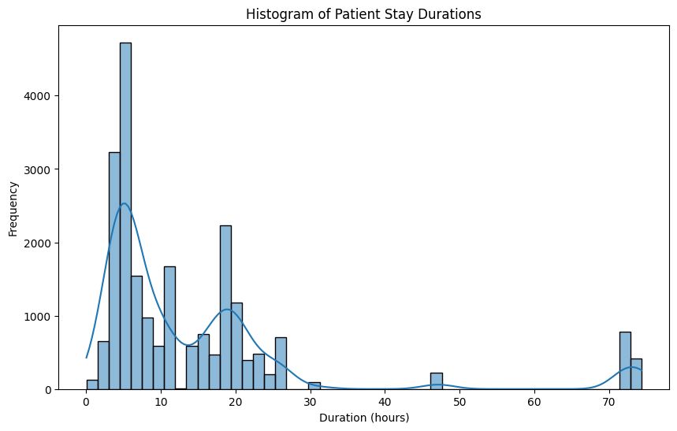
Patient Stay Durations
There’s a significant peak at around 5 hours, indicating that this is a common duration for patient stays. This means that most patients stay for around 5 hours.
Other noticeable but smaller peaks occur at approximately 20 hours, suggesting that these durations are also common, but less so than the 5-hour duration.
There are fewer patient stays of longer durations, as indicated by the decreasing frequency of stays longer than 70 hours. This could be because longer stays are often associated with more complex or severe health issues, which are less common.

Slide 9
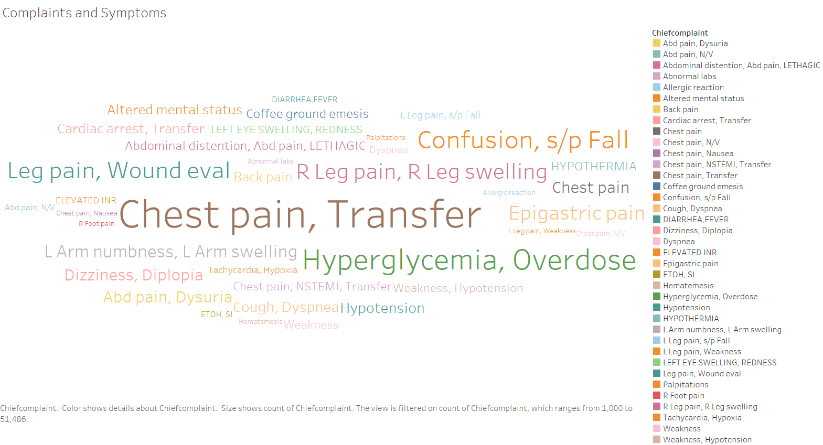
Subject Complaints and Symptoms

Slide 10
Key Findings
The word cloud indicates that most of the patients were either moved from another hospital or were admitted due to chest pain.
The second most common cause of ER admissions for patients was hyperglycemia and overdosage.
Abnormal test results and hematemesis were the least common reasons for ER admissions.

Slide 11
Machine Learning

Slide 12
Preparing our Data
A challenge encountered with the dataset was the presence of null values.
We removed the 'rhythm' column due to its 95% null values and categorical nature, which would have necessitated inappropriate data alteration if filled with mode.
Columns with missing values exceeding 5% were imputed with the mean of each respective columns (Temperature vs, o2sat vs, resprate vs). Pain Vs was filled using mode.

Slide 13
Encoding
Nominal Features:
For nominal features, we employed a Count Encoder. This encoding method replaces each category with the count of its occurrences in the dataset.
Ordinal Features:
For ordinal features which they have a clear order or hierarchy among their categories like ‘seq_num’ and 'acuity’, we utilizied an Ordinal Encoder..
Boolean Features:
Boolean features represent binary states, often denoting the presence or absence of a certain attribute like ‘icd_version’ and 'gender. For encoding Boolean features, we applied a One-Hot Encoder.
This approach aimed to maintain simplicity and manageability in the dataset, considering the existing high dimensionality with approximately 38 columns.

Slide 14
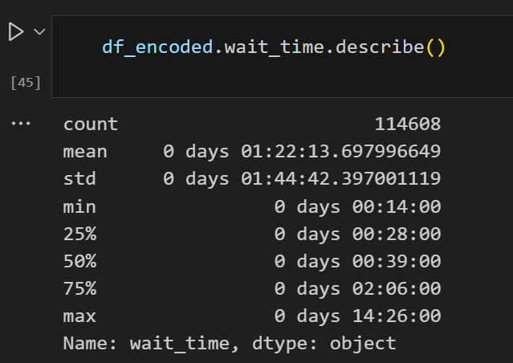
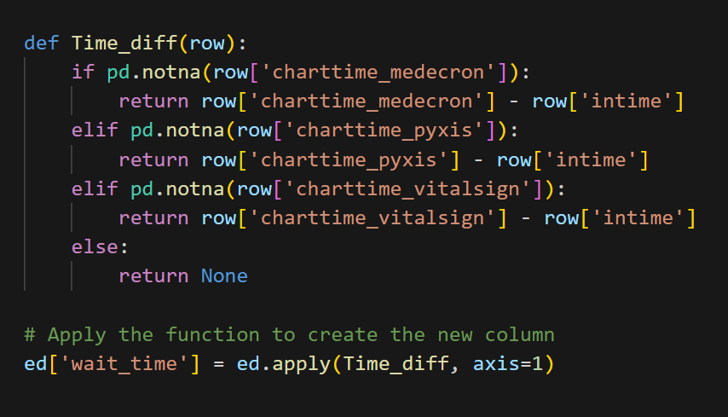
Feature Engineering

Slide 15
Feature Engineering
Our main aim was to find the wait time and to do this we had to subtract the Chart time and in time.
We created a new column – wait time to find the difference between the two and use it as our target variable.
By doing this we find that the minimum wait time for patients is 14 minutes, and the maximum wait time goes upto 866 minutes which is approximately about 14 hours.

Slide 16
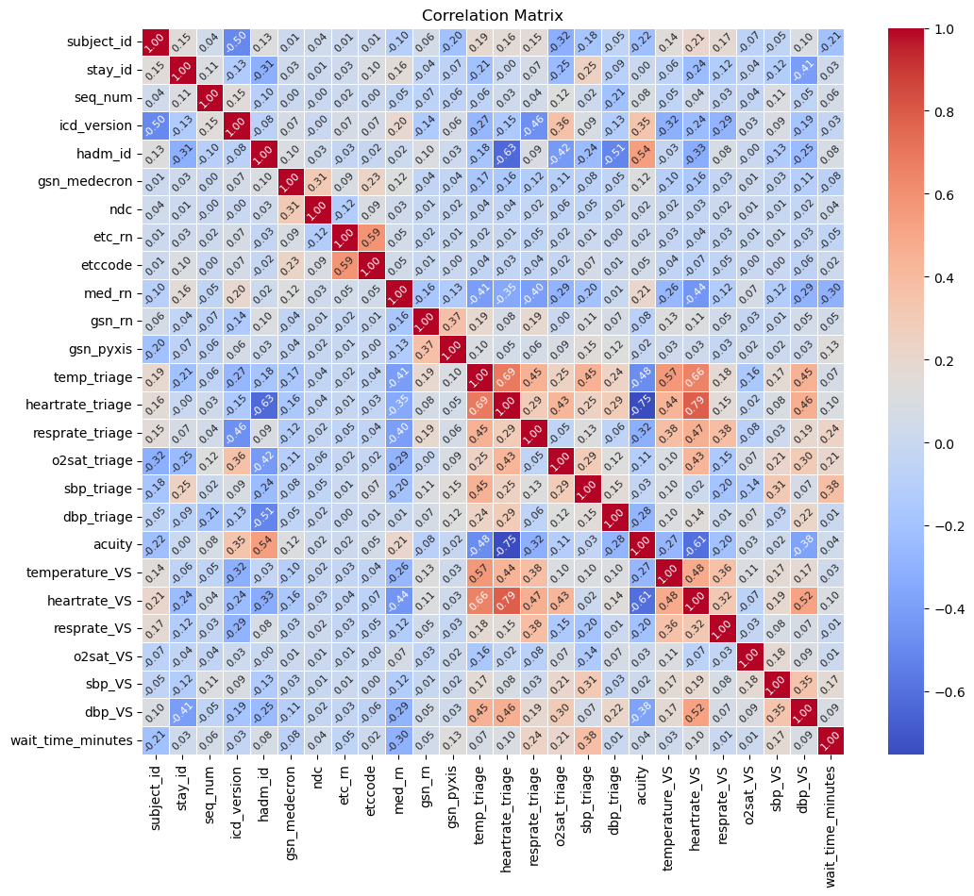
Correlation Matrix

Slide 17
Model 1
For our initial machine learning model, we focused on features identified through correlation analysis: resprate triage, o2sat triage, sbp_triage, and med_rn.
These features were selected based on their strong correlation with the target variable.
Utilizing this subset of features, we constructed our first predictive model using the AdaBoost Regressor algorithm.
The evaluation of this model yielded promising results:
Mean Squared Error: 741.15
R-squared Score: 0.935
Mean Absolute Error: 15.77

Slide 18
Following the initial model development, we employed Grid Search CV to optimize the parameters of our AdaBoost Regressor model.
The best parameters identified through Grid Search CV were as follows:
'base_estimator__max_depth': 8
'learning_rate': 1.0
'n_estimators': 100
Utilizing these optimized parameters, we evaluated the model performance, resulting in the following metrics:
Mean Squared Error: 313.33
Mean Absolute Error: 7.17
This highlights our efforts in parameter tuning and the improved performance achieved by fine-tuning the model parameters using Grid Search CV.

Slide 19

Model 2
Our next modeling iteration encompassed all features within our dataset, utilizing them to train an AdaBoost Regressor model.
The evaluation of this comprehensive model yielded the following performance metrics:
Mean Squared Error: 876.56
Mean Absolute Error: 19.96
R-squared Score: 0.923

Slide 20
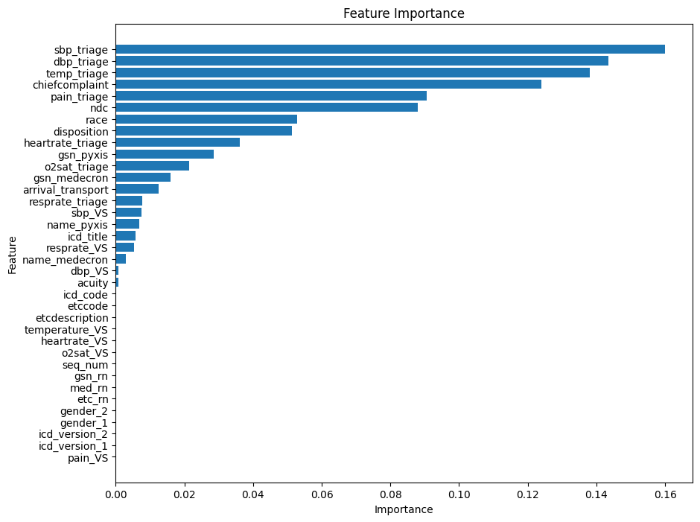
Feature Selection
Subsequent to feature selection, we retained features with importance percentages exceeding 5.0.
The selected features are as follows: 'chiefcomplaint', 'dbp_triage', 'pain_triage', 'sbp_triage', 'temp_triage', 'ndc', 'disposition','race', 'o2sat_triage’ (8/36)
Utilizing this refined feature set, we constructed a new dataframe and trained our third AdaBoost model.
The performance metrics of this model are as follows:
Mean Squared Error: 829.93
Mean Absolute Error: 19.20
R-squared Score: 0.927

Slide 21
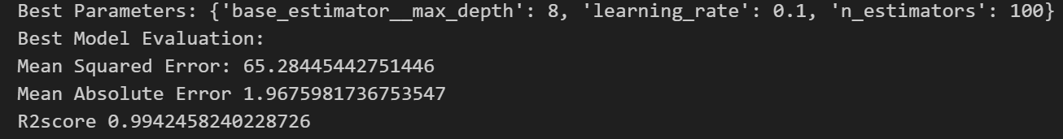
Hyper Param Tuning (Grid Search CV)
Employing grid search cross-validation, we fine-tuned the hyperparameters for our model trained on the selected features obtained from feature selection.
The optimized model yielded the following performance metrics:
Mean Squared Error: 65.28
Mean Absolute Error: 1.97
R-squared Score: 0.994
These results represent the evaluation outcomes of our model after hyperparameter tuning using grid search cross-validation.

Slide 22
Findings
Mean Squared Error (MSE): The MSE value of 65.28 indicates the average squared difference between the predicted wait times and the actual wait times in the emergency room. A lower MSE suggests that the model's predictions are closer to the actual values, which is desirable.
Mean Absolute Error (MAE): With an MAE of 1.97, the model's average absolute difference between predicted and actual wait times is quite low. This implies that, on average, our model's predictions deviate by approximately 1.97 minutes from the actual wait times.
R-squared Score (R2): The high R-squared score of 0.994 suggests that our model explains approximately 99.4% of the variance in the wait time data. This indicates that our model fits the data extremely well and is capable of making highly accurate predictions.

Slide 23

Deployment
Model Serialization
Technology Used: Pickle
Purpose: Serialized the trained model into a file for easy loading and inference.
File: model.pkl
Web Application (Framework: Flask)
Main Features:
Deployed the serialized model using Flask to handle web requests.
Allows user interaction through web forms and displays prediction results.
2. Endpoints:
/ (Home): Loads the home.html which serves as the main interaction page.
/predict (Prediction): Processes input from the form and displays prediction results or redirects to error page.
3. Error Handling:
error.html is used to display errors when form inputs are incorrect or missing, ensuring user-friendly error feedback

Slide 24
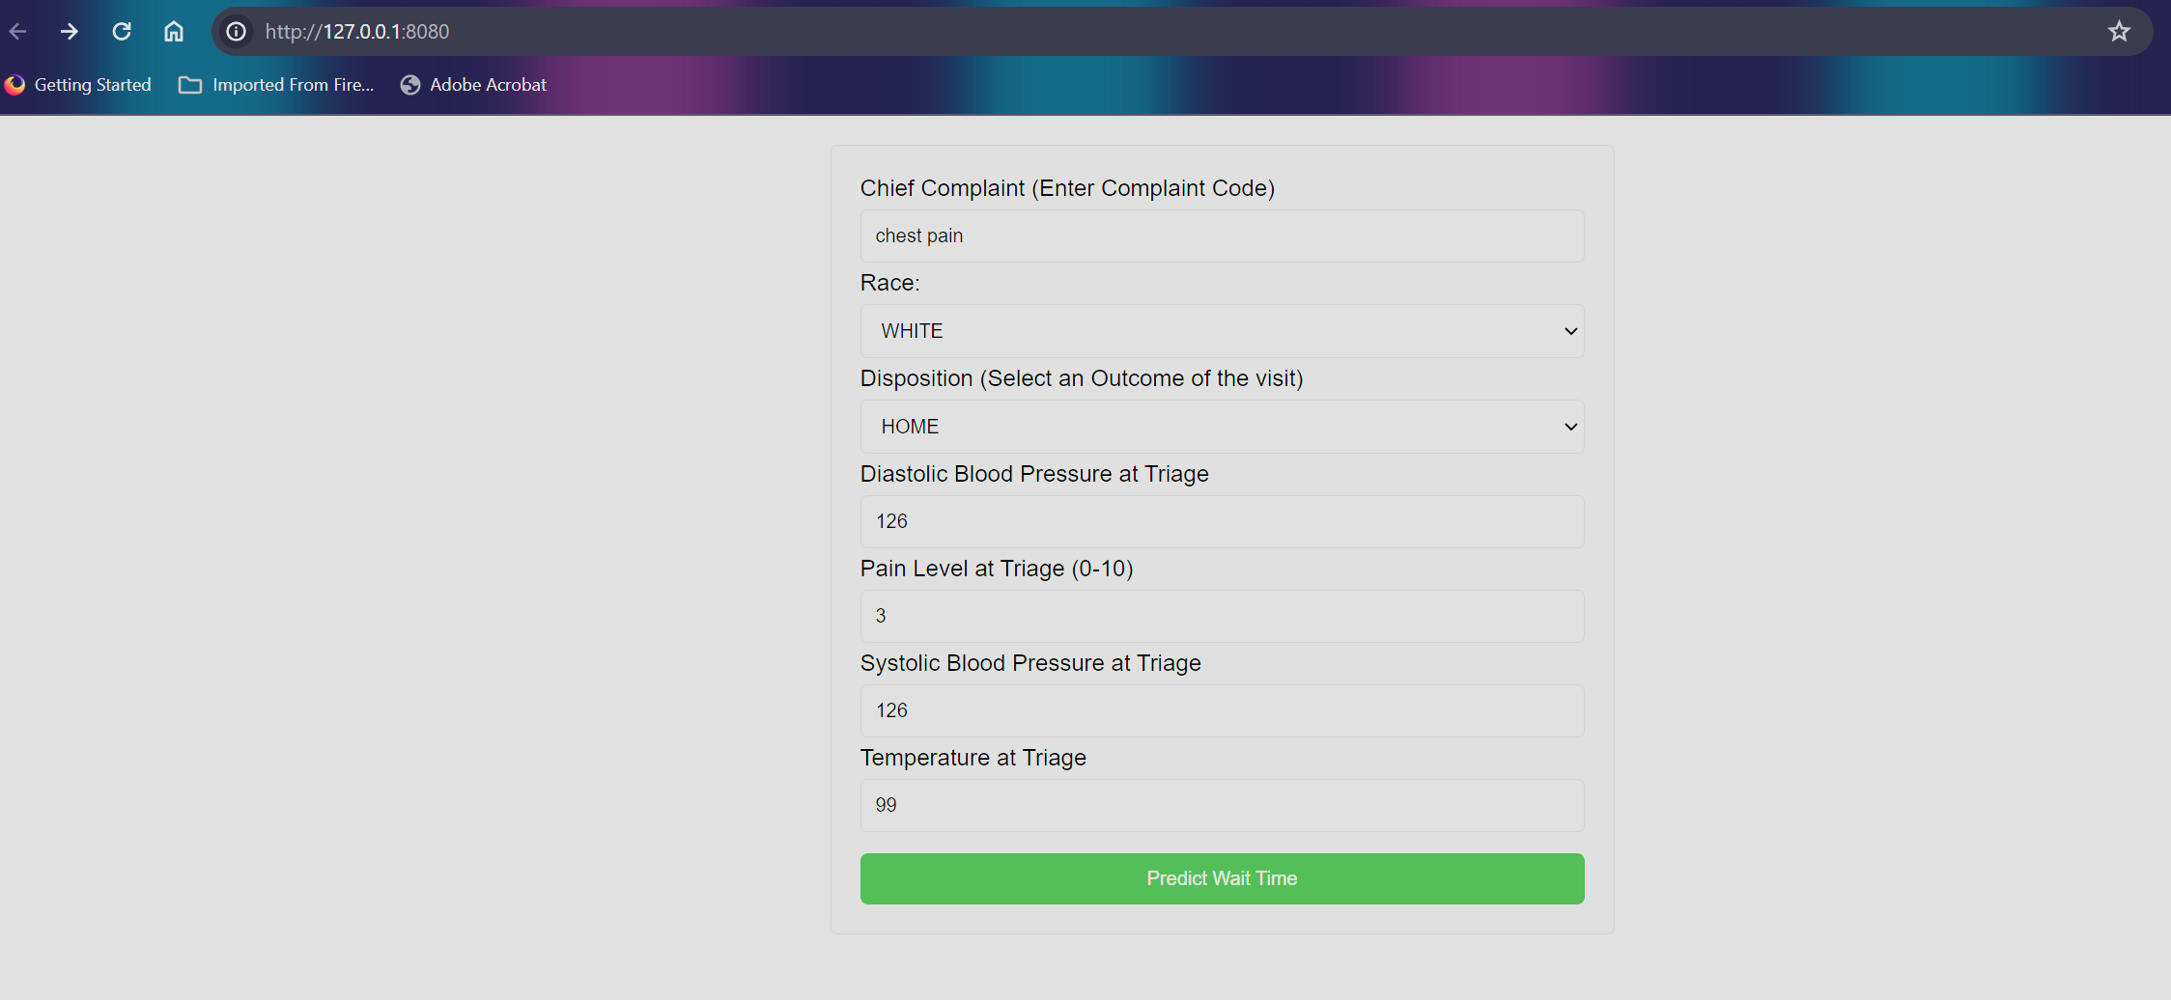
Webpage (home.html)

Slide 25
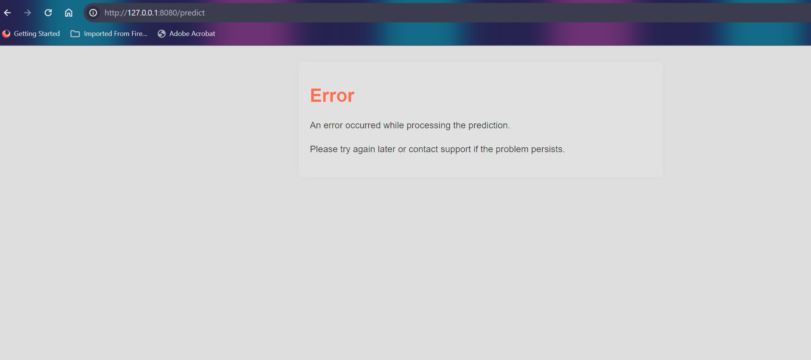
Error Handling (error.html)

Slide 26

Recommendations

Slide 27
Recommendations
Pre-arrival Information: Gather patient information (like chief complaint, pain level) before they arrive at the ED. This could be done through emergency medical services (EMS) in the field. This allows the ED to prepare resources and personnel in advance.
Predictive Modeling: Use the ML model to predict patient flow and waiting times based on real-time data. This can help manage resources more effectively and reduce waiting times.
Risk Stratification: The ML model can be used to stratify patients based on risk levels. Patients with higher risk (based on blood pressure, chief complaint, pain, temperature) can be attended to more quickly.

Slide 28
Correlation Matrix
Recommendations
Continuous Monitoring and Improvement: Continually monitor and analyze patient data to identify trends, bottlenecks, and areas for improvement. This should be an ongoing process, as factors affecting ED wait times can change over time.
Model Improvement: Continuously feed the model with new data to improve its predictive accuracy. Regularly evaluate and update the model to ensure it reflects the most current trends and patterns.
Decision Support: Use the ML model as a decision support tool for healthcare professionals in the ED. The model can provide data-driven insights to assist healthcare professionals in making quick decisions.

Slide 29


Conclusion

Slide 30
The integration of Machine Learning models in the emergency department, can significantly improve waiting times, however it is crucial to remember that while these tools provide valuable insights and predictions, they are created to assist, not to replace healthcare procedures or professionals.
Regular evaluation and updating of any machine learning model are necessary to maintain its accuracy and relevance.
Ethical considerations, as well as patient privacy and data security must always be at the forefront when implementing these technologies in healthcare.

Slide 31

Thank you

